Slide 1
DATA MODELING &
ER DIAGRAM BASICS
Database Concepts
Spring 2021
Week 2 – Lab 1

Slide 2
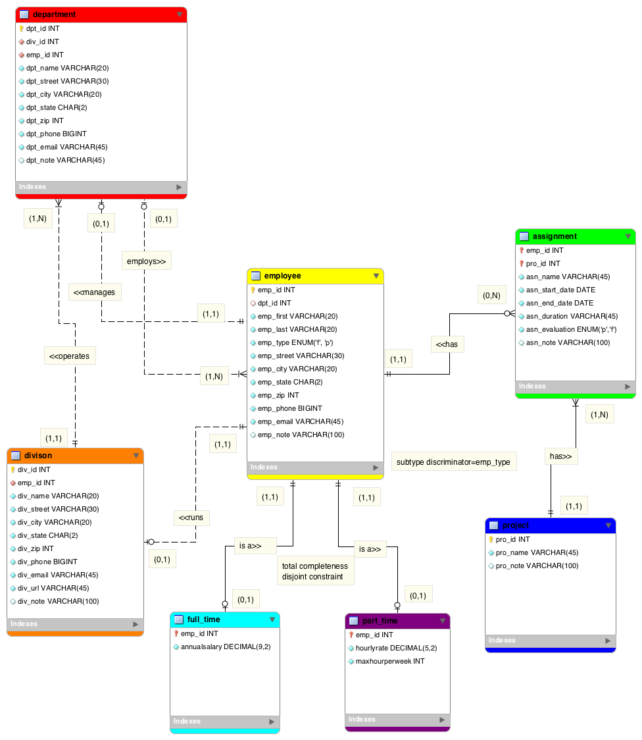
Notes:
Department employs Employee relationship: One-to-Many relationship. Department is optional in this relationship.
Division operates Department relationship: one-to-Many relationship. Both entities are mandatory in this relationship.
Employee has Project relationship: Many-to-Many relationship. Need to create an associative entity (called assignment) to split it to two one-to-many relationship.
Employee has Assignment relationship: One-to-Many relationship. Assignment is optional in this relationship.
Project has Assignment relationship: One-to-Many relationship. Both entities are mandatory in this relationship.
Employee manages Department relationship: One-to-One relationship. Department is optional in this relationship.
Employee runs Division relationship: One-to-One relationship. Division is optional in this relationship.

Slide 3
Entity Relationship Diagram (ERD)
Graphical representation of entities and their relationships in a database structure
ERD decribes the:
Conceptual database as viewed by end user
Database’s main components
Entities
Attributes (keys and non-key attributes)
Relationships

Slide 4
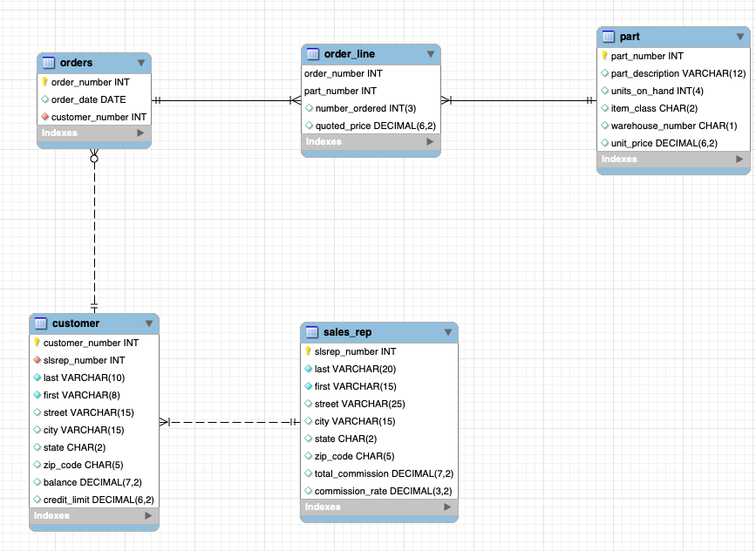

Slide 5
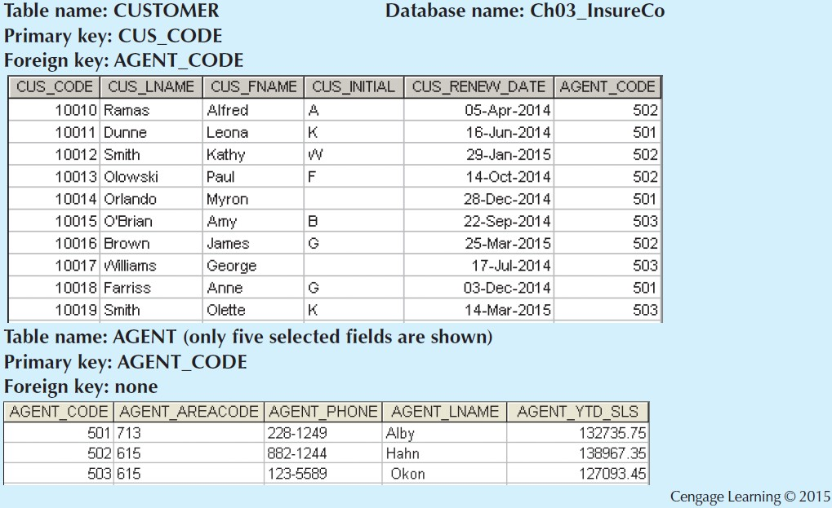
Notes:
Tables are related to each other through the sharing of a common attribute. The common link between the CUSTOMER and AGENT tables enables you to match the customer to his or her sales agent, even though the customer data are stored in one table and the sales representative data are stored in another table. Although the tables are independent of one another, you can easily associate the data between tables. The relational model provides a minimum level of controlled redundancy to eliminate most of the redundancies commonly found in file systems.

Slide 6
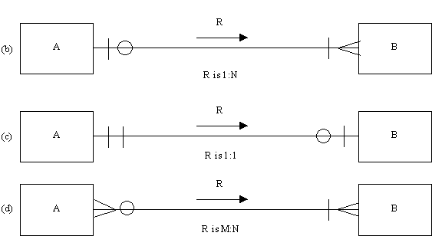
Relationship Type
minimum # of records of “B” that can be associated with one record of “A”
maximum # of records of “B” that can be associated with one record of “A”
Notes:
Look at (b) customer and agent connectivity.
The connectivity of a relationship is its classification. It may be a one to one (1:1), one to many (1:M) or many to many (M:N) relationship.
The cardinality of a relationship is the number of instances of entity B that can be associated with entity A. There is a minimum cardinality and a maximum cardinality for each relationship.
First example: A: order; B: item
Second example: A: person; B: library account
Third example: A: teaching assistant; B: course

Slide 7
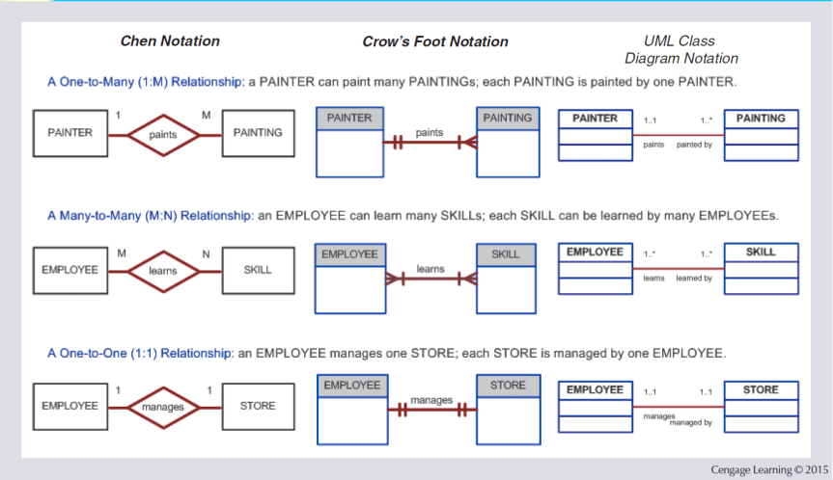
Figure 2.3 - The ER Model Notations
Notes:
the original Chen notation: the connectivities are written next to each entity box. Relationships are represented by a diamond connected to the related entities through a relationship line. The relationship name is written inside the diamond.
the Crow’s Foot notation: the connectivities are represented by symbols. the relationship name is written above the relationship line.
the newer class diagram notation, which is part of the Unified Modeling Language (UML): the connectivities are represented by lines with symbols (1..1, 1..*). Also, the UML notation uses names in both sides of the relationship.

Slide 8
Business Rule Examples – Class Activity
An EMPLOYEE has one or more COMPUTERs. A COMPUTER has only (exactly) one assigned EMPLOYEE.
“One customer can generate many invoices. Each of the many invoices is generated by only one customer” (p. 49,Chapter 2).
Each professor can advise one or many students; each student can be advised by only one professor.

